Slide 1
PHASED ARRAY SPEAKER SYSTEM
Under the guidance of,
S. Bibin Sam Paul
Assistant Professor (sr. Gr.)
By,
MohammedArsath(120051601063)
RajaRaman.G(120051601094)
Rohit Kumar.S(120051601101)
Final Year, ECE - B

Slide 2
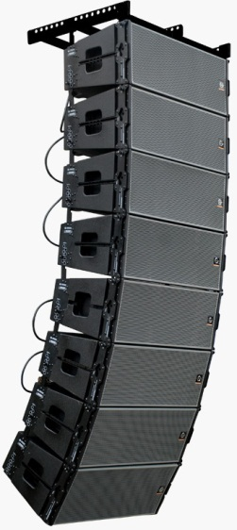
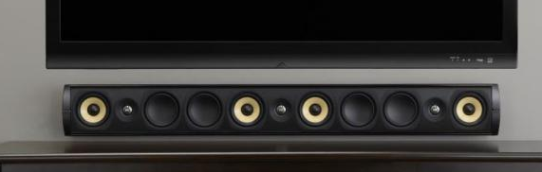
PHASED ARRAY SPEAKERS
Over the past few decades, digital signal processors (DSPs) have become available at a reasonable cost. This forces the question Now that it is possible to individually control the magnitude and phase of every loudspeaker in an array called phase array speaker system.
Manipulating the magnitude and phase of every loudspeaker in an array of loudspeakers is commonly referred to as “beam steering.”
Line Array systems
Phase Array systems

Slide 3
OBJECTIVE
The aim of the phased array speakers is to provide the maximum sound coverage over an entire area along with best sound clarity. The voices and the sound effects could be more easily differentiated. This system is comparatively cheaper when compared with its counterparts.

Slide 4
INTRODUCTION
A phased array speaker system to generate flexible, directional sound.
The system samples a standard audio input signal at approximately 44.1 kHz, and then outputs this signal to each of 6-12 speakers, each with a variable delay.
This simple technique allows audio frequency sound to be heard in only selected regions within the room or other auditory space.
Multiple regions with multiple soundtracks can be created by simultaneously playing variously delayed soundtracks over each of the speakers in the array.
Sound waves from different loudspeakers can both combine or cancel depending on the relative phase relationships between the sound waves, it is possible to manipulate the phase (and magnitude) of the sound from two or more loudspeakers to control where the sound cancels and where the sound sums.

Slide 5
HARDWARE DESIGN
X12
STANDARD AUDIO INPUT
INPUT BUFFER/LEVEL SHIFTER
AADC
ATMEGA 644 MICROCONTROLLER
DAC
SPEAKER AMPLIFIER

Slide 6
SOFTWARE USED
WinAVR used for programming the microcontroller.
EAGLE software to design circuits for fabrication.

Slide 7
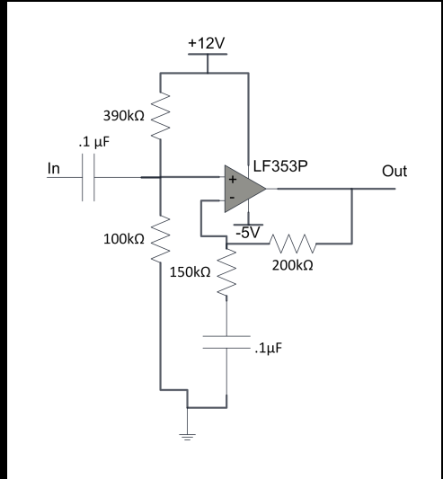
PRE AMPLIFIER CIRCUIT
Corner frequency of this input high pass filter 1/(RC)= 1/(.1u*80k)
=125hz.
The amplification factor is 1+(R1/R2)=1+(200k/150k)
=2.33

Slide 8
DESCRIPTION
The first stage is a high­ pass filter and re­-biasing circuit, implemented by the first capacitor and the resistor divider.
The second stage of the input amplifier is implemented with an LF353P Op-­Amp in a non­-inverting amplifier.
It amplifies only the high ­frequency components due to the capacitor between the lower resistor and ground.
Voltage swing from -1V to +1V to be converted to -2.33V to +2.33V finally it will be almost double to 5v.

Slide 9
ALGORITHM
Initialization of microcontroller.
Declaration of buffers.
Setting up of timer and ADC.
Discrete audio signals are delayed with appropriate coding and o/p is sent to respective i/p pins of DAC.

Slide 10
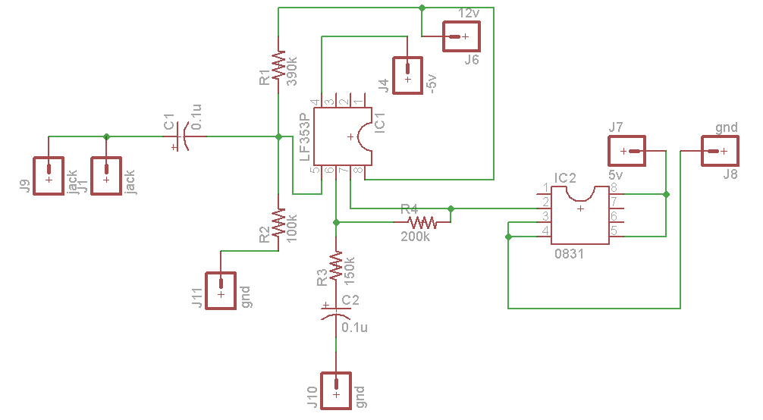
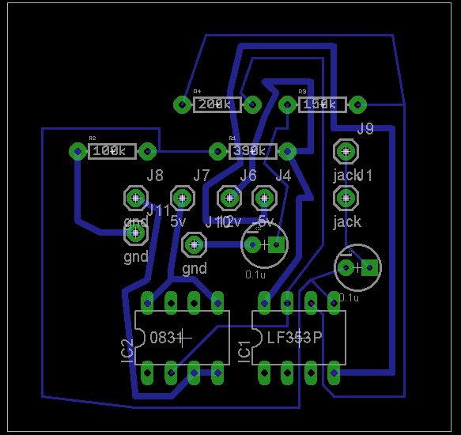
PRE AMPLIFIER ON EAGLE SOFTWARE

Slide 11
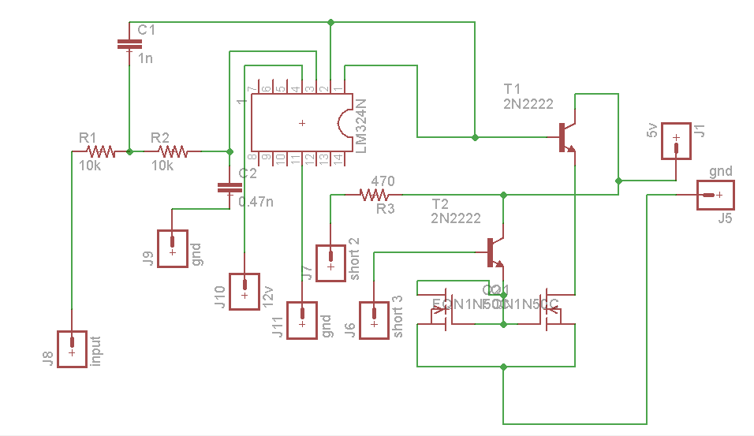
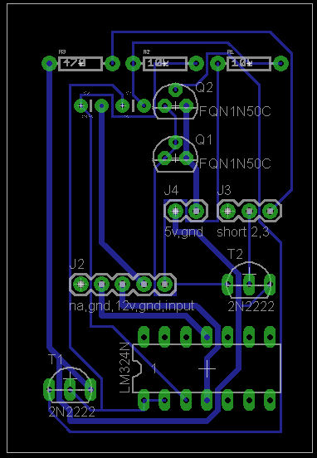
POST AMPLIFIER ON EAGLE SOFTWARE

Slide 12
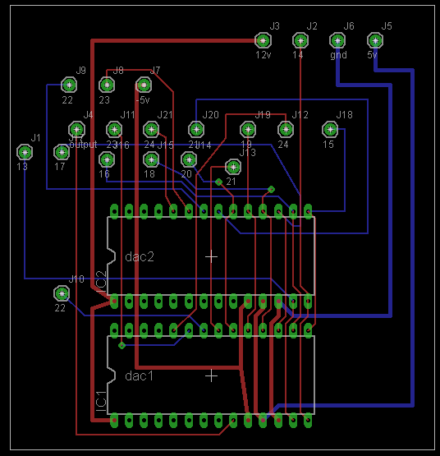
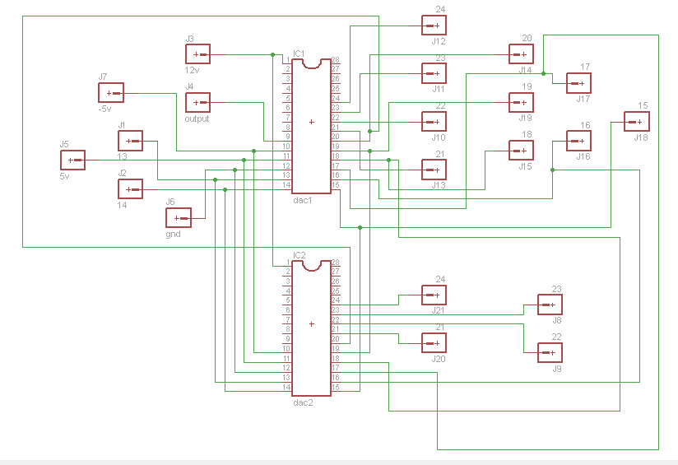
DAC ON EAGLE SOFTWARE

Slide 13
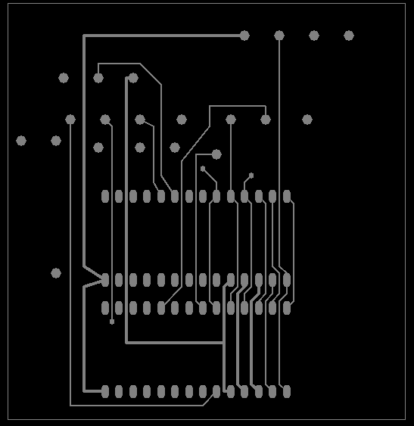
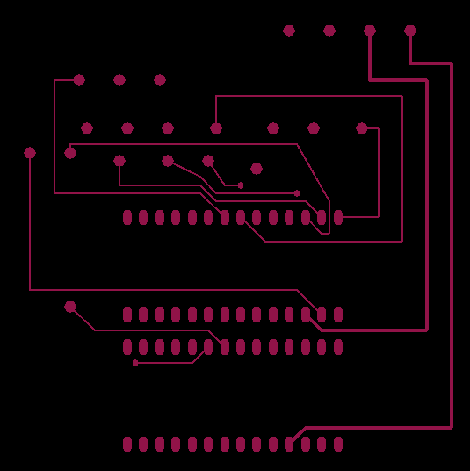
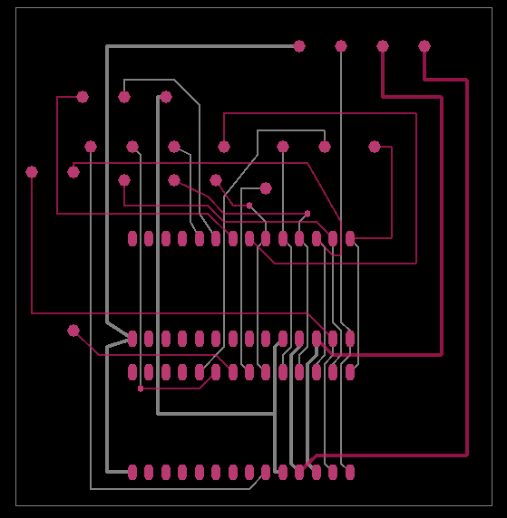
PCB LAYER IN DAC DESIGN
TOP LAYER BOTTOM LAYER DOUBLE LAYER

Slide 14
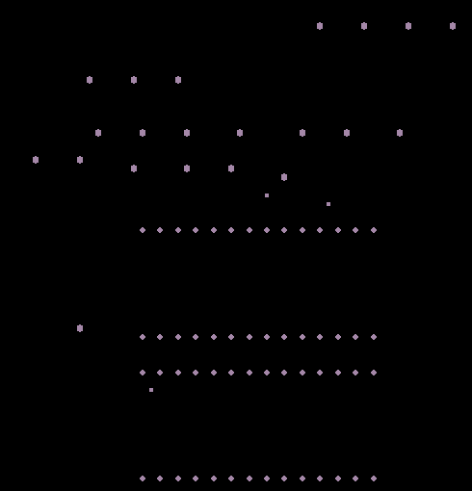
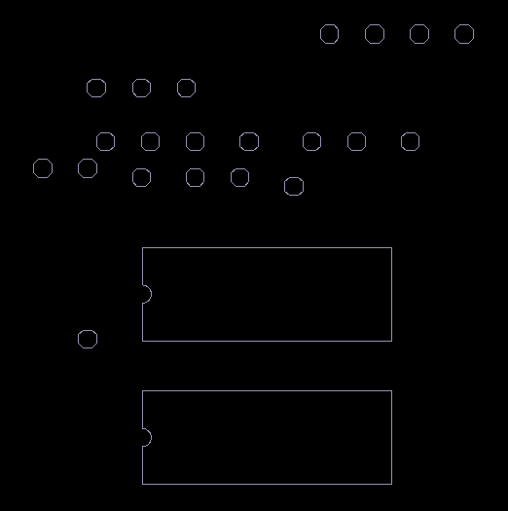
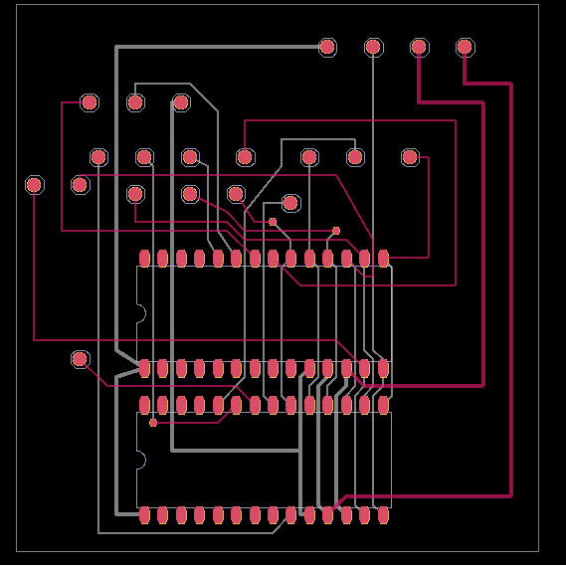
PCB LAYER IN DAC DESIGN
DRILL LAYER SILK SCREEN OVERALL DESIGN

Slide 15
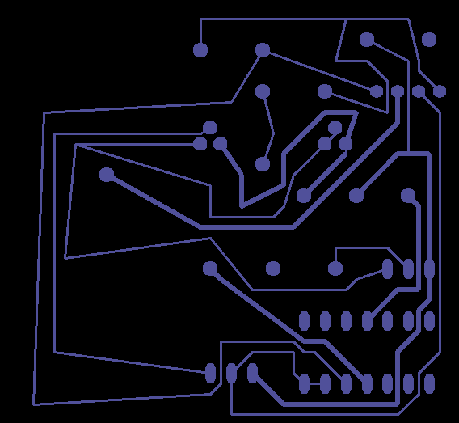
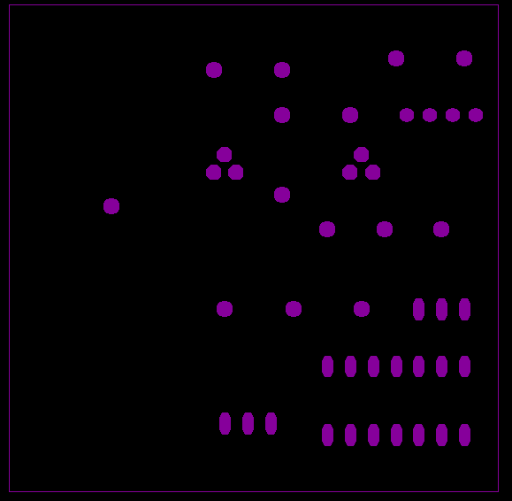
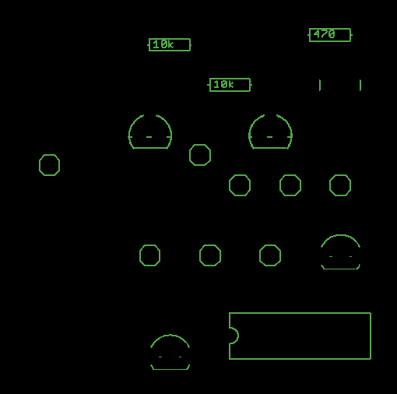
PCB LAYER FOR POST AMPLIFIER
BOTTOM LAYER TOP LAYER SILK SCREEN

Slide 16
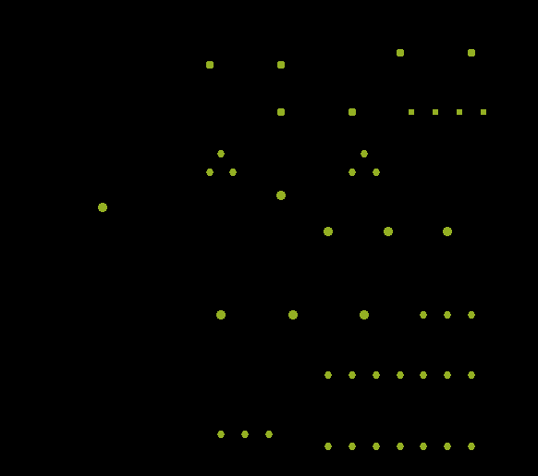
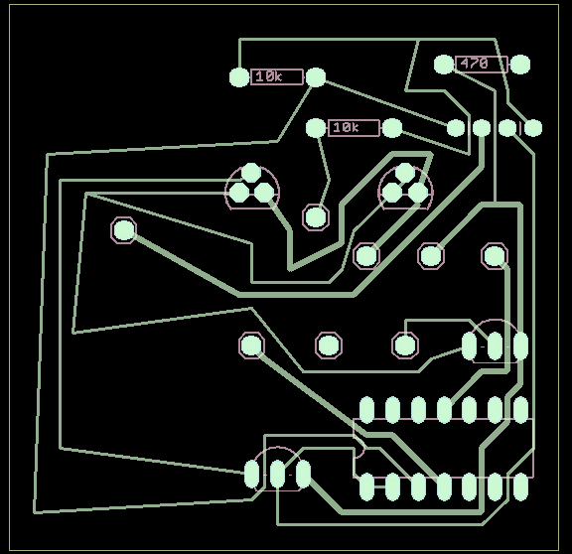
PCB LAYER FOR POST AMPLIFIER
DRILL LAYER OVERALL DESIGN

Slide 17
PCB LAYER FOR PRE AMPLIFIER
TOP LAYER BOTTOM LAYER SILK SCREEN LAYER

Slide 18
PCB LAYER FOR PRE AMPLIFIER
DRILL LAYER OVERALL DESIGN

Slide 19
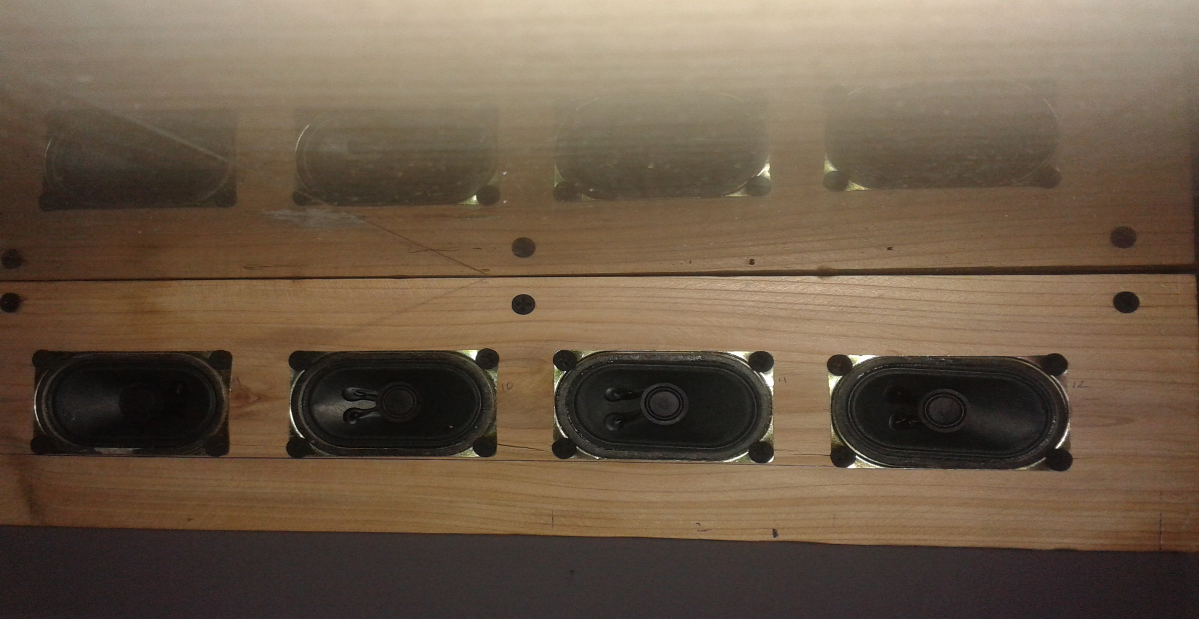
SPEAKER ALIGNMENT

Slide 20
APPLICATIONS
Quadraphonic
Sonar testing apparatus
Enhancing bass

Slide 21
WORKS To Do
Soldering of components on PCB.
Alignment of Component on hardware.

Slide 22
REFERENCES
Paul Crilly, Richard Hartnett, Rosie Santrach, Carlos Palenzuela Department of Engineering, Electrical Engineering, U.S. Coast Guard Academy, New London “A Novel Approach to Teaching Phased Array Antenna Systems ”

Slide 23
THANK YOU

